Slide 1
Pogramming of microcontorllers: Syrup dispenser
Project by Franziska Rothen & Meindi Zahiri

Slide 2
features
inputs
outputs
LCD menu for navigation
Weighing scale to determine glass size
Choice of syrup percentage via potentionmeter
Motor?
Valves
Communication between the two µ-controllers

Slide 3
Functionalities
SPI: LCD Screen
Timer: Debouncing
GPIO: Weighing scale
ADC: Potentiometer
USART: Communication

Slide 4
Spi – lcd screen
LCD_Driver library
Navigation:
Move forward in menu via button
Display prompts and results
General Info

Slide 5
Spi – lcd screen
int step = 0;
if(button pressed)
step ++;
if(step == 0)
menu1_display();
else if(step == 1){
menu2_display();
other_functionalities();
}
else if (step == 2)
…
Pseudocode

Slide 6
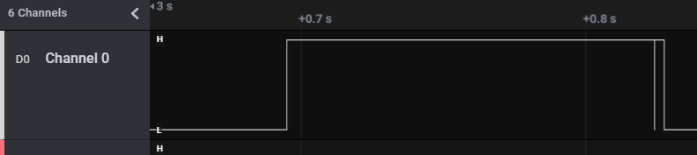
Timer – debouncing
Problem: skip step in menu
Solution:
Flag button_state
Timer delay
TIM 1
Interrupt mode
Internal clock
Frequency = 20Hz
General Info

Slide 7
Timer – debouncing
bool button_state = true;
if(button pressed && button_state == true){
start timer;
button_state = false;
}
if(timer period elapsed){
if(button in reset??){
step ++;
button_state = true;
stop timer;
}
}
Pseudocode

Slide 8
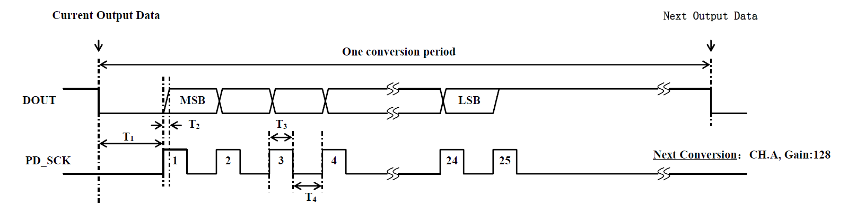
GPIO – weighing scale
HX711: 24-Bit Analog-to-Digital Converter (ADC) for Weigh Scales
HX711 library
2 GPIO pins:
DOUT (input)
PD_SCK (output)
Calibration
Check weight for glass size
Check weight to stop syrup at percentage
General Info

Slide 9
adc – potentiometer
ADC 1
12-bit mode
Scan conversion mode: enabeled
Values divided into 20 segments
5% up to 25% syrup (switch case)
General Info

Slide 10
usart – communication
USART 1
Asynchronous mode
Information to send:
Open/close the valves
Move the glass
General Info

